Slide 1
Online Entry instructions for the Dutchess County Fairgrounds “dutchessfair.com”

Slide 2
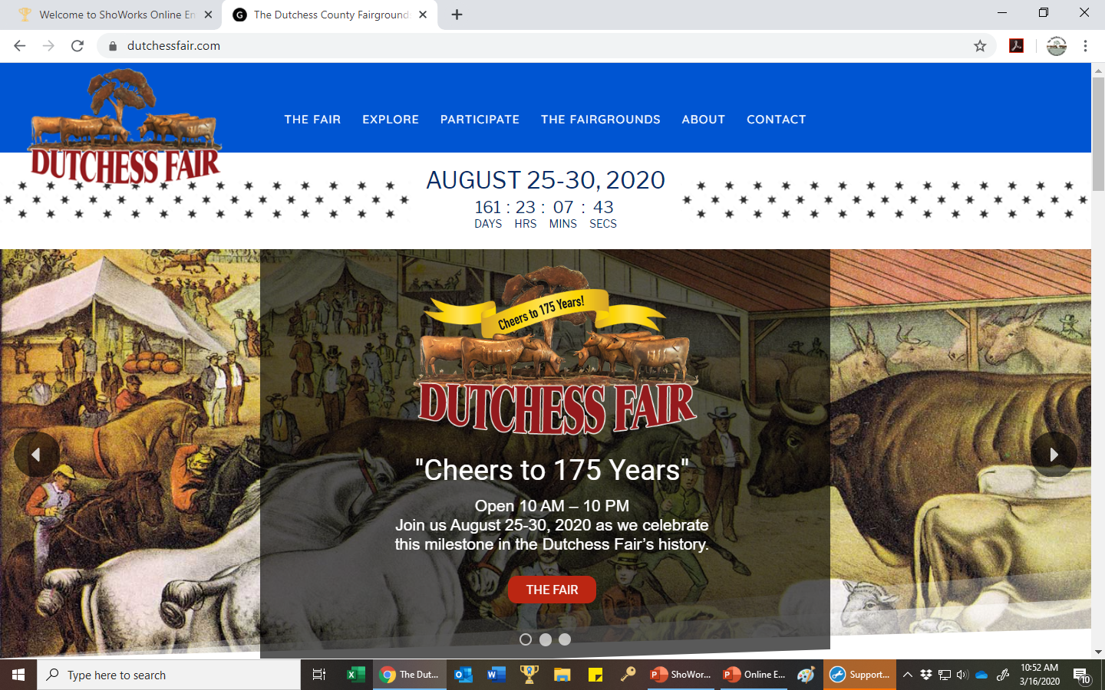

Slide 3
For the Fair: Click on “Participate” and then “Exhibitors and Competitions” Go to entries by clicking any red “Enter Online” box. For ENY: Click “The Fairgrounds” and then “Events” under the ENY you will find the entry link.

Slide 4
This will bring you to the Home Page for Online Entries. For this slide show I will use the “ENY Summer Classic” home screen because it will soon be open for entries. The Fair may be slightly different in logos and color scheme.

Slide 5
In the “I’m a…..:” drop-down list choose the Passport option if you have already created a passport, you will simply have to add your password. If you have not setup passport yet this is your opportunity to do so. I recommend passport because it allows notifications and to keep your account (free) to use from year to year. The following 5 slides guide you through (Easy!) Passport set-up.

Slide 6
Type in Username (email is best) and click “I don't yet have a ShoWorks Passport but want to create one” To proceed to the next step in passport click “Continue”

Slide 7
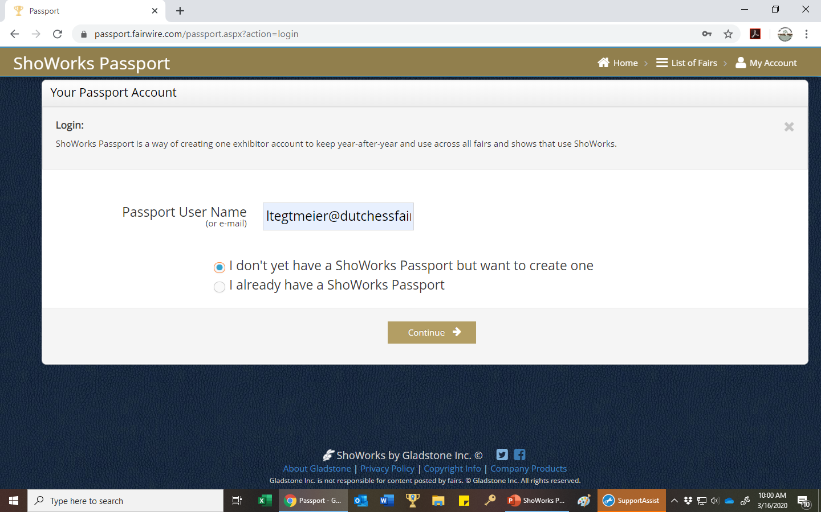
To proceed to the next step click “Continue” **If you are a parent of exhibitors, it is best to create a passport for each child. In this case you may want to use a user id other then email so that you can put your email on every account. User Id’s need to be unique. Example: Johnny Doe could be “Jdoe”. Passwords can be the same for every child.

Slide 8
Your Passport Account
Fill in your account information. Fields marked with a “*” are required! Remember your password, keep it simple! There are no restrictions on the password it is be as simple as “1”.
Please Note: The top right corner:
The Home button will always get you back log in screen.
List of Fairs you can simply search “Dutchess” to find our competitions.
My Account will always get you back to your “Personal Information” screen.

Slide 9
On this screen simply re-check you account information and click “continue”.

Slide 10
On the left is your Passport “Home” page. Please keep all information current! To edit this information simply click on the blue “Edit Info” link. Click on “List of Fairs” in the Search box type “Dutchess” You will see all the competitions we are taking entries for. Currently entries for the ENY Summer Classic are open. Dutchess County Fair entries will open June 1, 2021. To make your entries click on the show and proceed with the entry process.

Slide 11
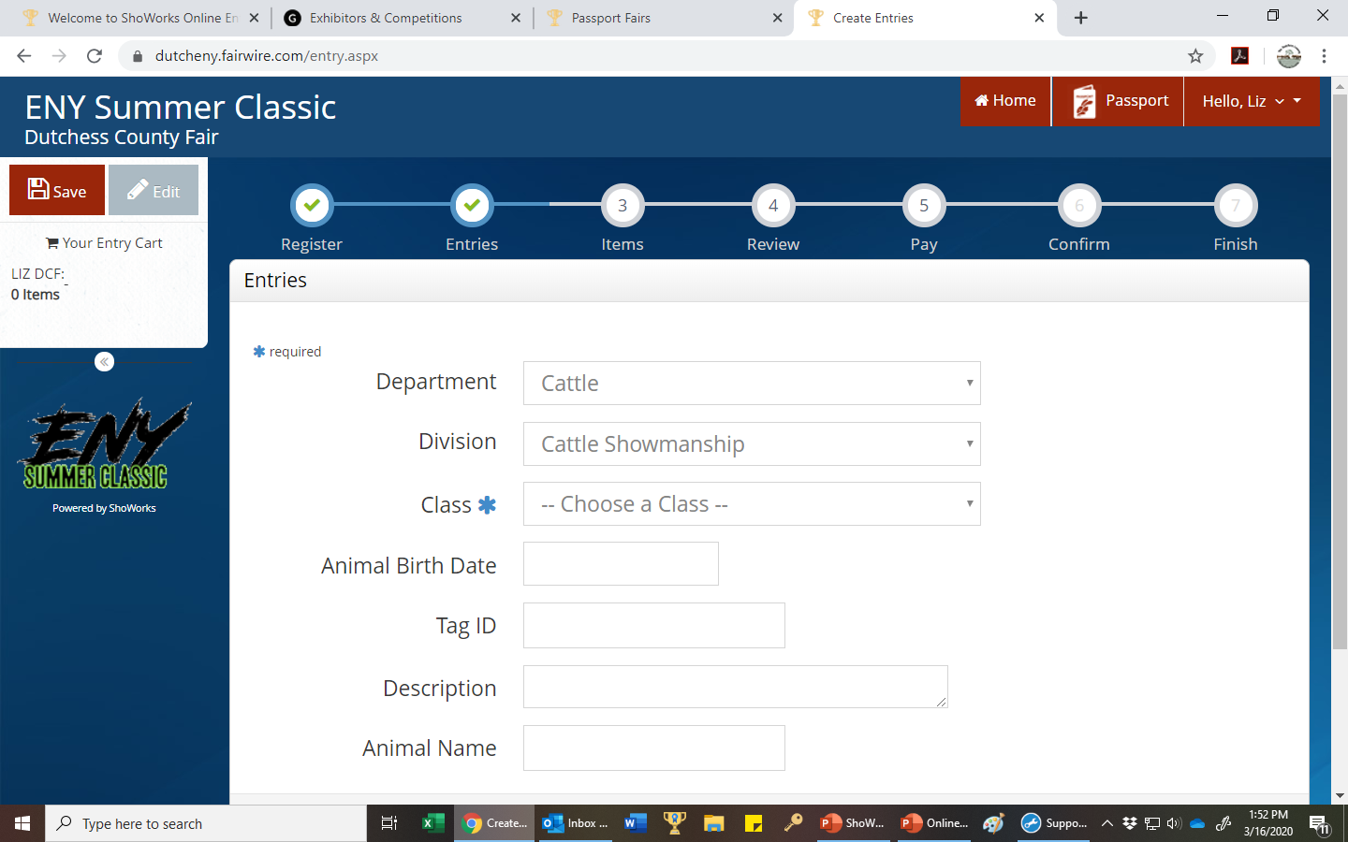
*Choose your Department, Division and Class by using the drop-down menus.
*Use “Add Entry to Cart” button to save the class to your cart.
*The “Cart” will appear along the left-hand column of the screen.
*The fields with a blue (*) are required!

Slide 12
Important Notes:
You can navigate through the entry process by using the round buttons at the top of the screen. A check mark will appear when that part of the process is complete. You can go back to review any step at any time.
If you do not have the required information your “Cart” can be saved by clicking the “Save” button. You can go in later with your name and password and update the information.
All 4-H departments and divisions will have “4-H” at the front of the department and division!
Suggestion – People always forget their password, for the entry program just keep it simple. Please remember, passwords are case sensitive!
In the next step “Step 3 - Items” You only need to fill in if you need any extra’s (for ENY Summer Classic it may be a camping spot for the DC Fair it may be a horse show stall.) These extra’s will be added to your cart.

Slide 13
ShoWorks will now give you a summary of your cart information. Review and double check your information! You can “Save this cart for later” or “Checkout” at this point. Remember to complete your entries before the closing date!

Slide 14
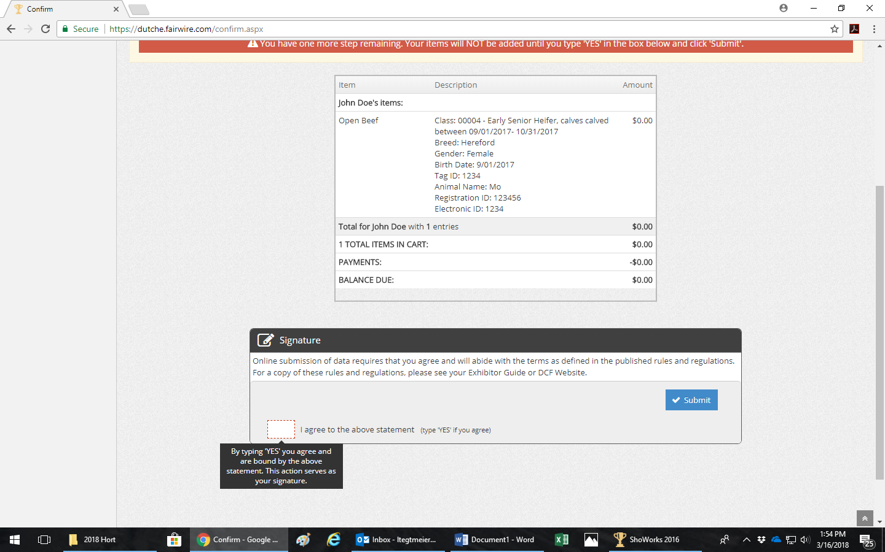
Follow the online instructions through the checkout process. Just as you would when online shopping! When you get to the “Confirm” step you must type “yes” to agree that you have made the correct entries. Also, by typing yes you agree to follow all the rules and regulations as listed . Please type “yes” and click “Submit”.

Slide 15
We strongly recommend you email your entry details by checking and filling out the appropriate box! Then click the “Finish” button.

Slide 16
At this time, you can rate the ShoWorks entry process. Thank you for entering online!
Why do your entries online?
It is fast, easy, and saves time!
You will have a permanent record of your entry that is accessible at any time.
If your information is incomplete, you can save and complete.
Remember, your entry must be completed by the closing date.
Secure online payments and processing 24/7.
No deciphering of handwriting means fewer data errors.
Saves paper, a fantastic way to go green!

Slide 17
Please Remember!
*Your login information, write it down! Keep your case sensitive password simple (Can even be as simple as “1”)
*Review or have your leader check your entries before completing!
*You can add classes up until midnight of the closing date!
*You can not delete classes, if a class is entered by mistake email entries@dutchessfair.com to be removed from class.
*All 4-H departments/divisions begin with “4-H”
Liz Tegtmeier’s contact information:
ltegtmeier@dutchessfair.com or entries@dutchessfair.com
Entry office phone number 845-876-2789 (June – September)
Otherwise, 845-876-4000

